Slide 1
EXPLORING HOW SOCIOECONOMIC FACTORS INFLUENCE THE COST OF CHILDCARE & WOMEN PARTICIPATION IN THE WORKFORCE
BAYPATH UNIVERSITY CAPSTONE PROJECT

Slide 2
Data from the Bureau of Labor Statistics stated that the cost of daycare has risen roughly 36%, outpacing the rise in inflation.
67% of parents are spending 20% of annual income per child on childcare.
Lack of affordable daycare and higher childcare cost significantly impacts economic mobility and workforce participation which can create significant barriers for women in the workforce.
MOTIVATION

Slide 3
Center-based care - Providers care for children in non-residential settings
Home-based care - Providers care for children in residential settings
Women’s Labor Participation Rate - A percentage of the total that shows the extent to which women are active in the labor force.
CARE CENTER
DEFINITIONS

Slide 4
Infant - Age 0-23 months
Toddlers - Age 24-35 months
Preschool - Age 36-60 months
School-Age - Age 5-12 years
AGE GROUP
DEFINITIONS

Slide 5
Small county - 1-99,999
Mid size county - 100,000-499,999
Large county - 500,000-999,999
Very Large County - 1,000,000+
COUNTY SIZE CLASSIFICATION

Slide 6

2018 Dataset - The Women’s Bureau - U.S Department of Labor.
DATASET

Slide 7
Data Collection
Data Preprocessing
Exploratory Data Analysis
Visualization
Model Evaluation
METHODOLOGY

Slide 8
EXPLORATORY
DATA ANALYSIS

Slide 9
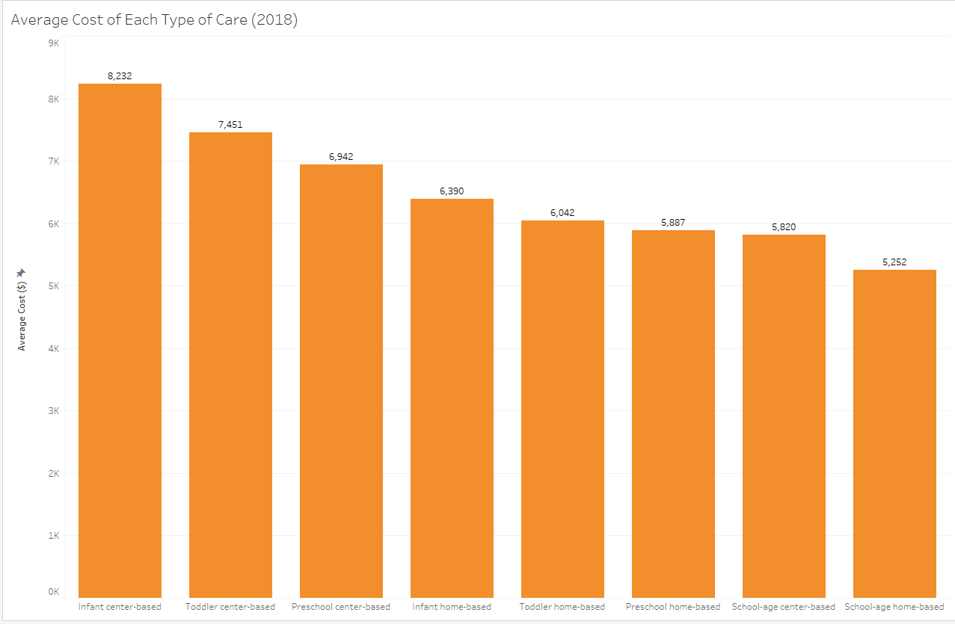
Infant center-based care, the costliest childcare option, averaged $8,232 in 2018 - equivalent to $10,296 in 2024.

Slide 10
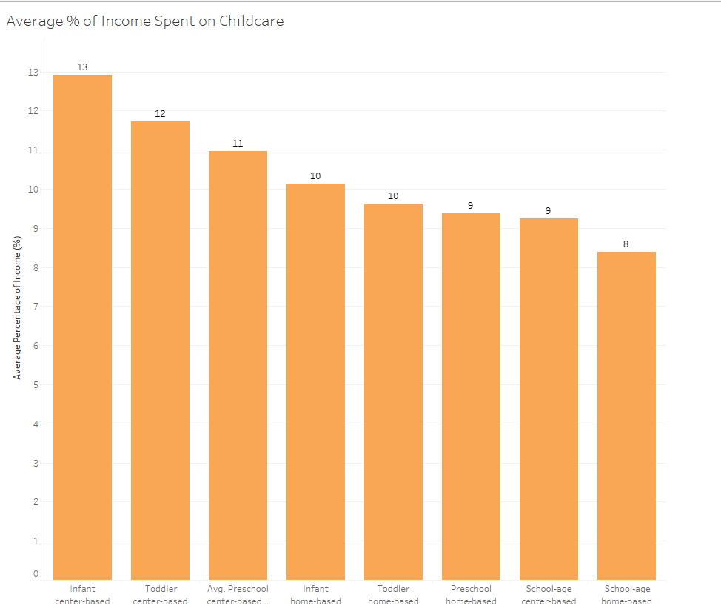
Infant center-based care, the costliest childcare option, averaged 13% of annual income

Slide 11
CHILDCARE COSTS ARE INFLUENCED BY SOCIOECONOMIC FACTORS
HYPOTHESIS 1

Slide 12

MEDIAN INCOME
Higher median family income is associated with a lower percentage of income spent on childcare costs as a percentage of family income across all types of childcare.

Slide 13
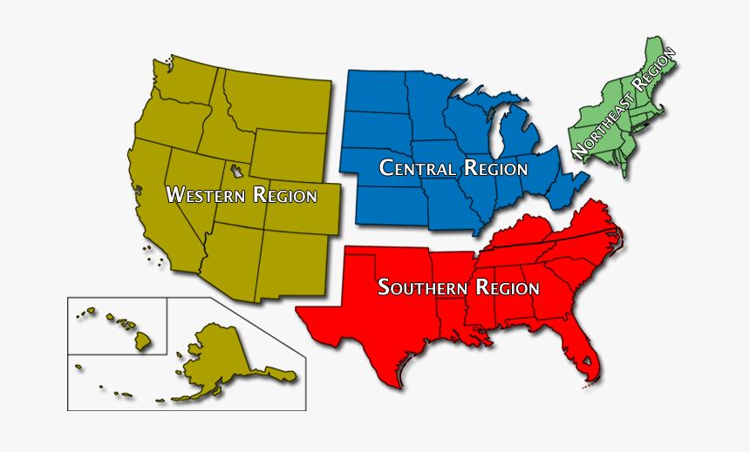
REGION
Refrence Region | Region | Preschool Center-Based Care | School Age Center-Based Care
Midwest | Northeast | 2.44% | 2.81%
Northeast | South | -2.61% | -2.45%
Northeast | West | -1.14% | -1.05%

Slide 14
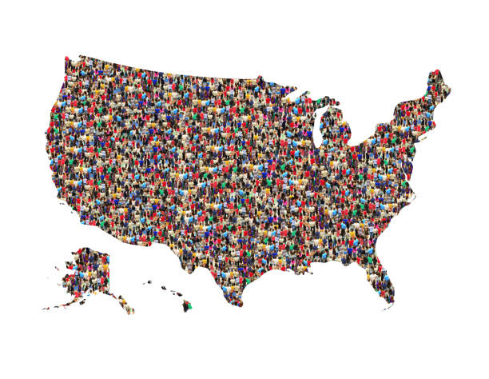
COUNTY SIZE
Childcare costs, as a percentage of family income, tend to decrease as county population size decreases. Very large counties have the highest childcare costs across all childcare categories.

Slide 15
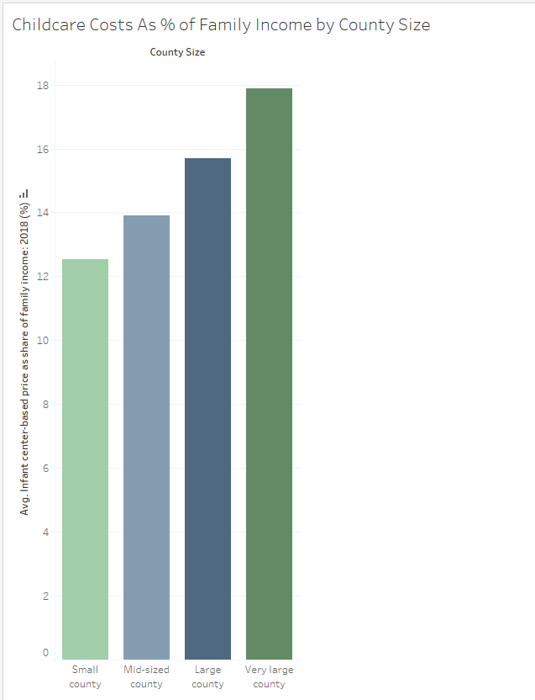
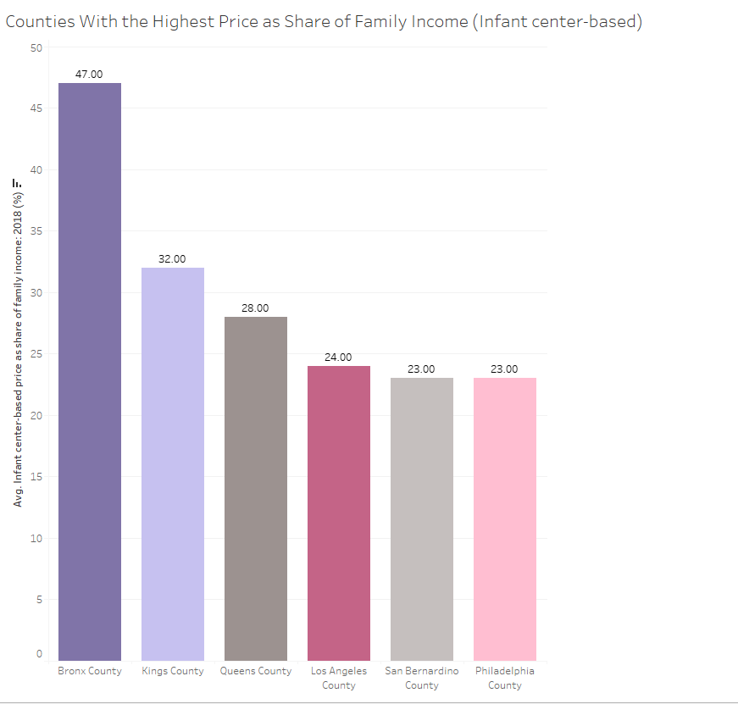
COUNTY SIZE
Very large counties tend to have the highest % of annual income spent on childcare costs

Slide 16
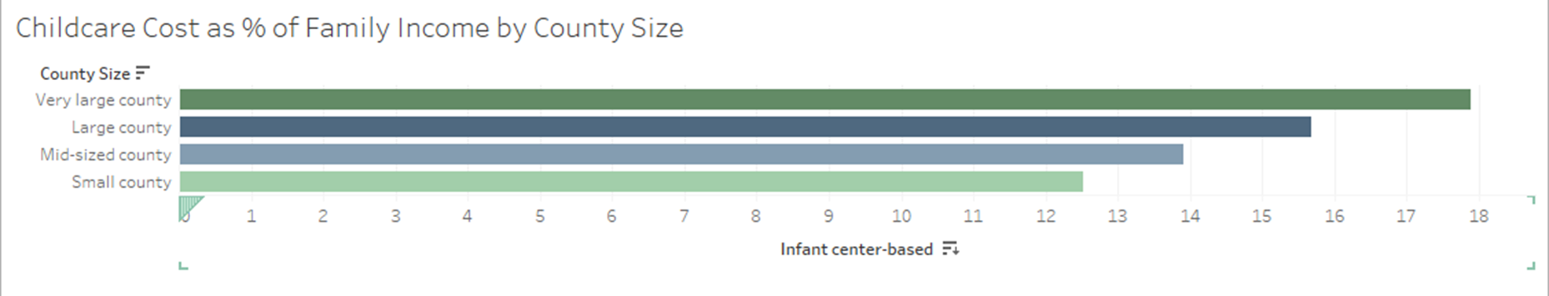
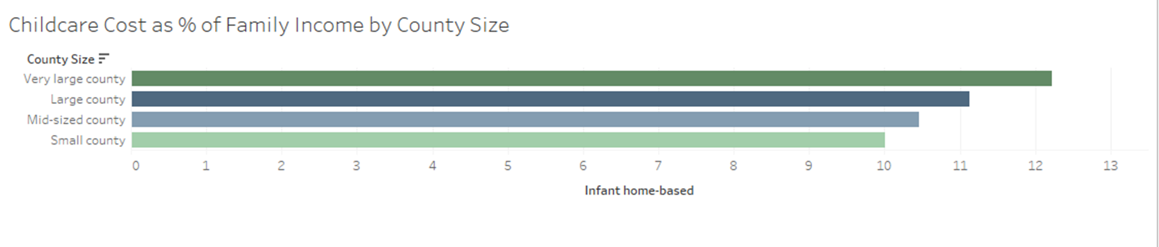

Slide 17
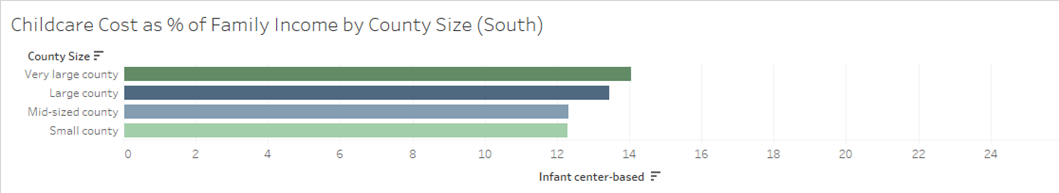
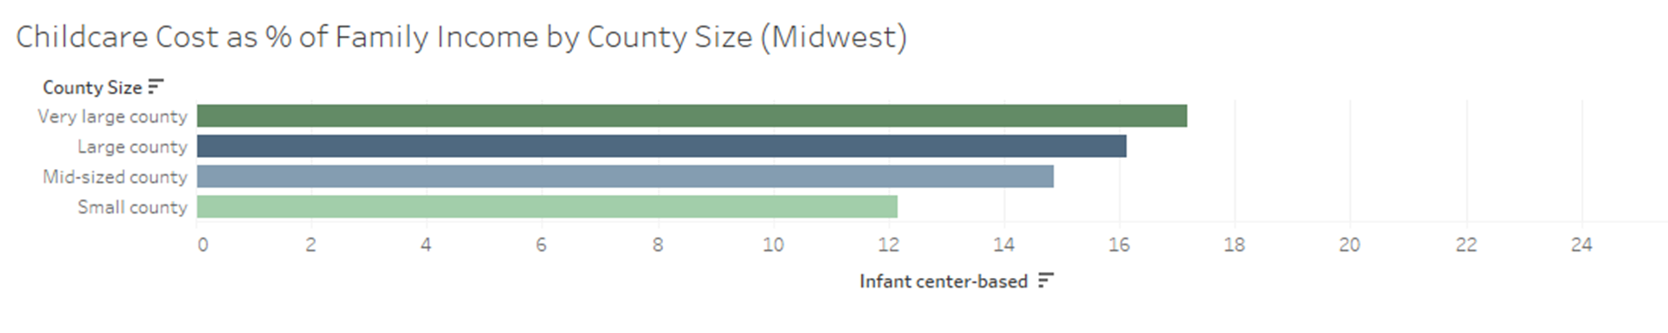

Slide 18
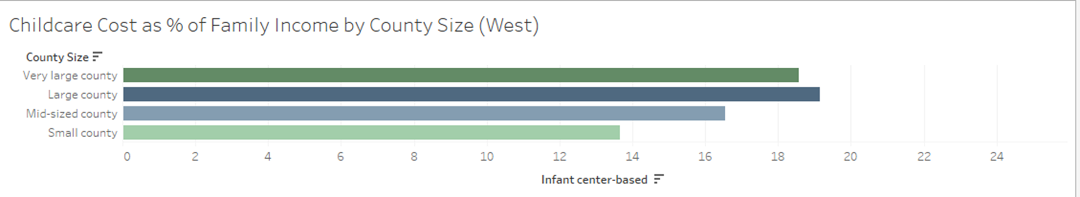
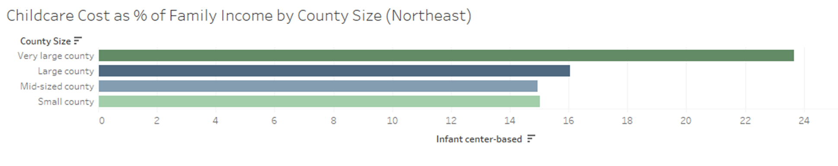

Slide 19
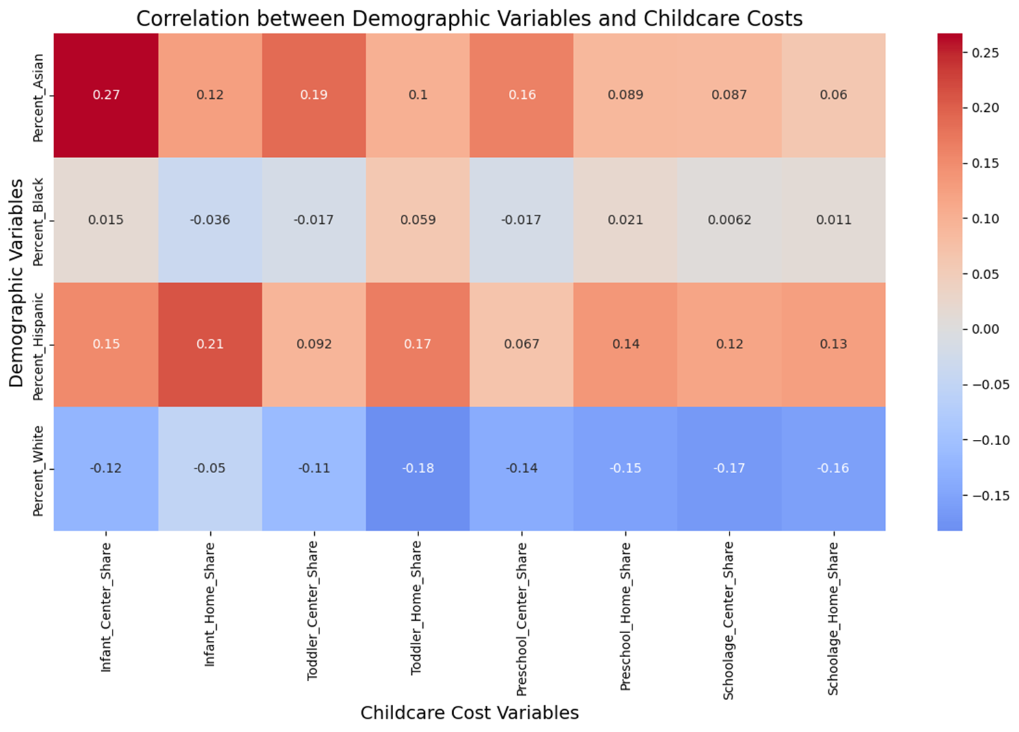
RACE

Slide 20
HIGHER PERCENTAGES OF ASIAN AND HISPANIC POPULATIONS ARE GENERALLY ASSOCIATED WITH HIGHER CHILDCARE COSTS ACROSS ALMOST ALL CATEGORIES
HIGHER PERCENTAGES OF WHITE POPULATIONS ARE GENERALLY ASSOCIATED WITH LOWER CHILDCARE COSTS ACROSS ALL CATEGORIES
RACE

Slide 21
REGIONS IN THE US WITH HIGHER CHILDCARE COSTS AS A PERCENTAGE OF FAMILY INCOME TEND TO HAVE LOWER WOMEN'S LABOR FORCE PARTICIPATION RATES.
HYPOTHESIS 2

Slide 22
Higher childcare costs correlate with lower labor force participation
Home-based care has a stronger impact than center-based care on women participation rate
Regional differences suggest other factors influence participation rates.
REGIONAL RESULT

Slide 23
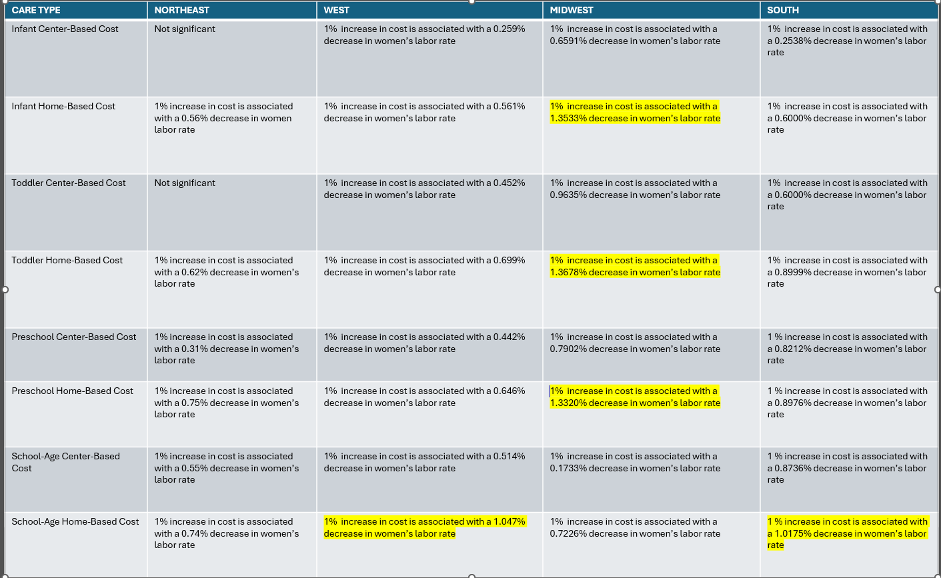

Slide 24
Preschool and school-age home-based and center-based care showed a higher impact on women labor rate
NORTHEAST
School-age home-based and center-based care showed a higher impact on women labor rate
WEST
Infant, Toddler, Preschool & School-age home-based and center-based care showed a negative impact on women labor force participation rate
MIDWEST
SOUTH
Infant, Toddler, home-based and center-based care showed a negative impact on women labor force participation rate

Slide 25
RECOMMENDATIONS
NORTHEAST
Increase funding for home-based preschool and infant care
Increase funding for after school and summer care programs
WEST
MIDWEST
Increase subsidies for home-based childcare across all type of care.
SOUTH
Focus on reducing costs for home-based care

Slide 26
Childcare cost is not the only predictor of women’s participation rate! It plays a role but there are more variables that tell a story!
Childcare cost is impacted by region. Can we build region specific model to determine what other factors contribute to women labor participation rate?
MAIN SUMMARY

Slide 27
Lack of data on childcare costs and quality of child care and factoring for socioeconomic variables
Lack of data on both men and women participation rate for childcare type
Lack of comprehensive studies that analyze the intersection of childcare costs with various socioeconomic factors such as income levels, geographic regions, and care settings
LIMITATION

Slide 28
County Size is not significant in the Northwest, Midwest and the South only the West.
MODEL BUILDING

Slide 29
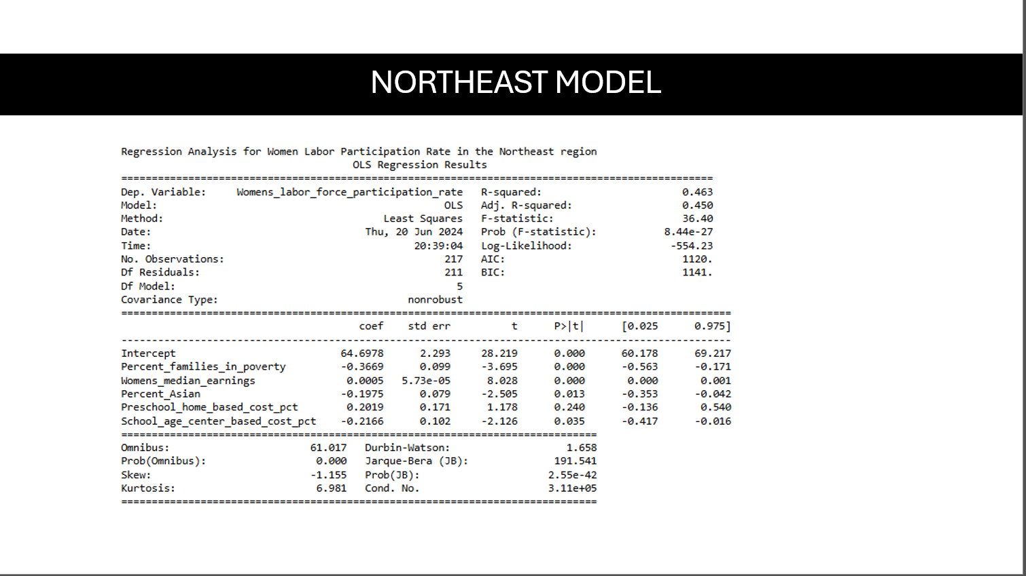

Slide 30
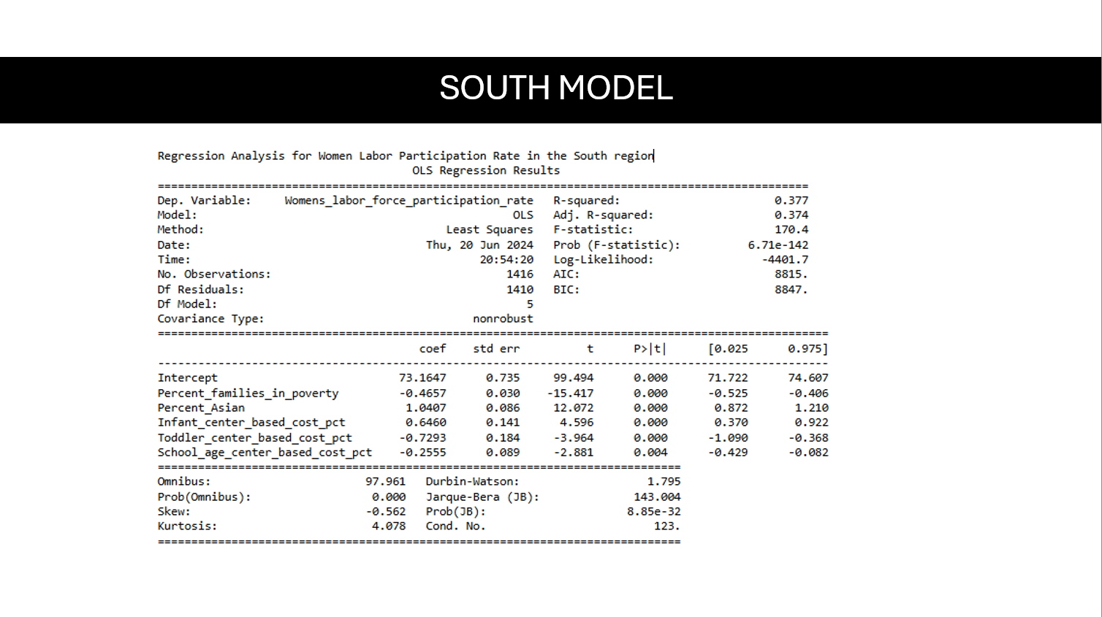

Slide 31


Slide 32
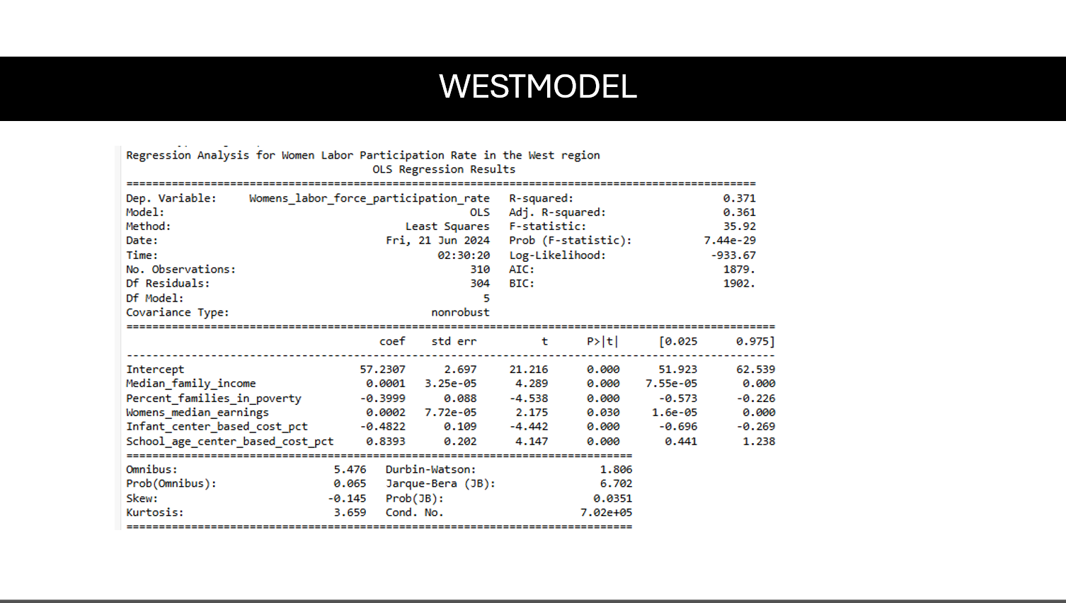

Slide 33
Model validation across regions indicated that socioeconomic factors are complex and multifaceted, with childcare costs being only one part of the broader picture. This study highlights the intricate relationship between childcare costs and women's labor force participation, emphasizing the need for policy interventions to make childcare more affordable by providing region-specific solutions.
FINAL THOUGHTS

Slide 34
WHAT IF I HAD 6 MORE MONTHS?

Slide 35
THANK YOU

